Slide 1

Day 5 — Few-shot vs Zero-shot Prompting
Presented by CloudByteHub.ai • © 2025 T S Narayana Reddy • An Independent Personal Project

Slide 2



Why Prompting Matters
Prompts control how models respond.
Zero-shot: No examples provided.
Few-shot: A few guiding examples.
Carefully crafted prompts are the steering wheel for large language models, dictating their output and behavior.
The model relies solely on its pre-trained knowledge to fulfill the request, offering maximum flexibility.
Providing a small set of input-output pairs helps the model understand the desired task and format.

Slide 3
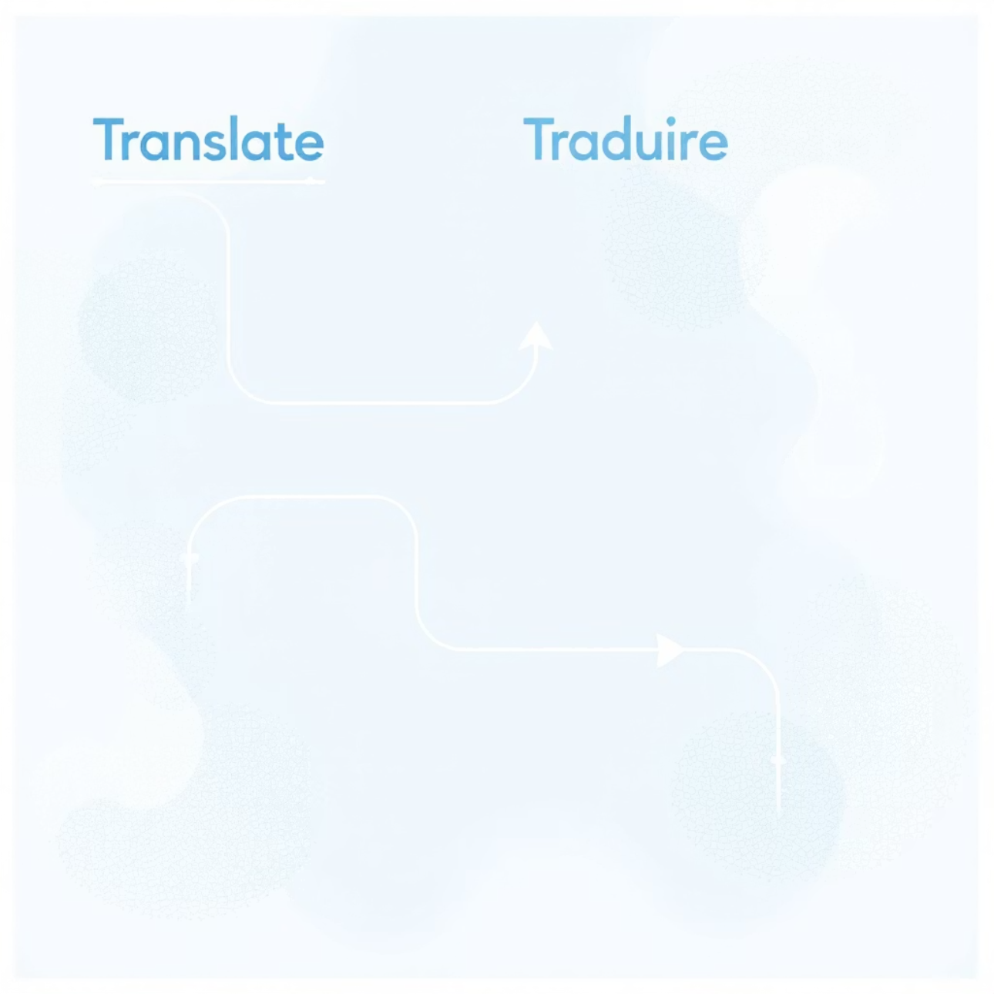
Zero-shot Example: The Direct Approach
Prompt: Translate 'Good night' to French
In zero-shot prompting, you provide only the instruction and the specific input, trusting the model's inherent understanding of the task. It's straightforward and requires minimal preparation.
Expected: Bonne nuit

Slide 4
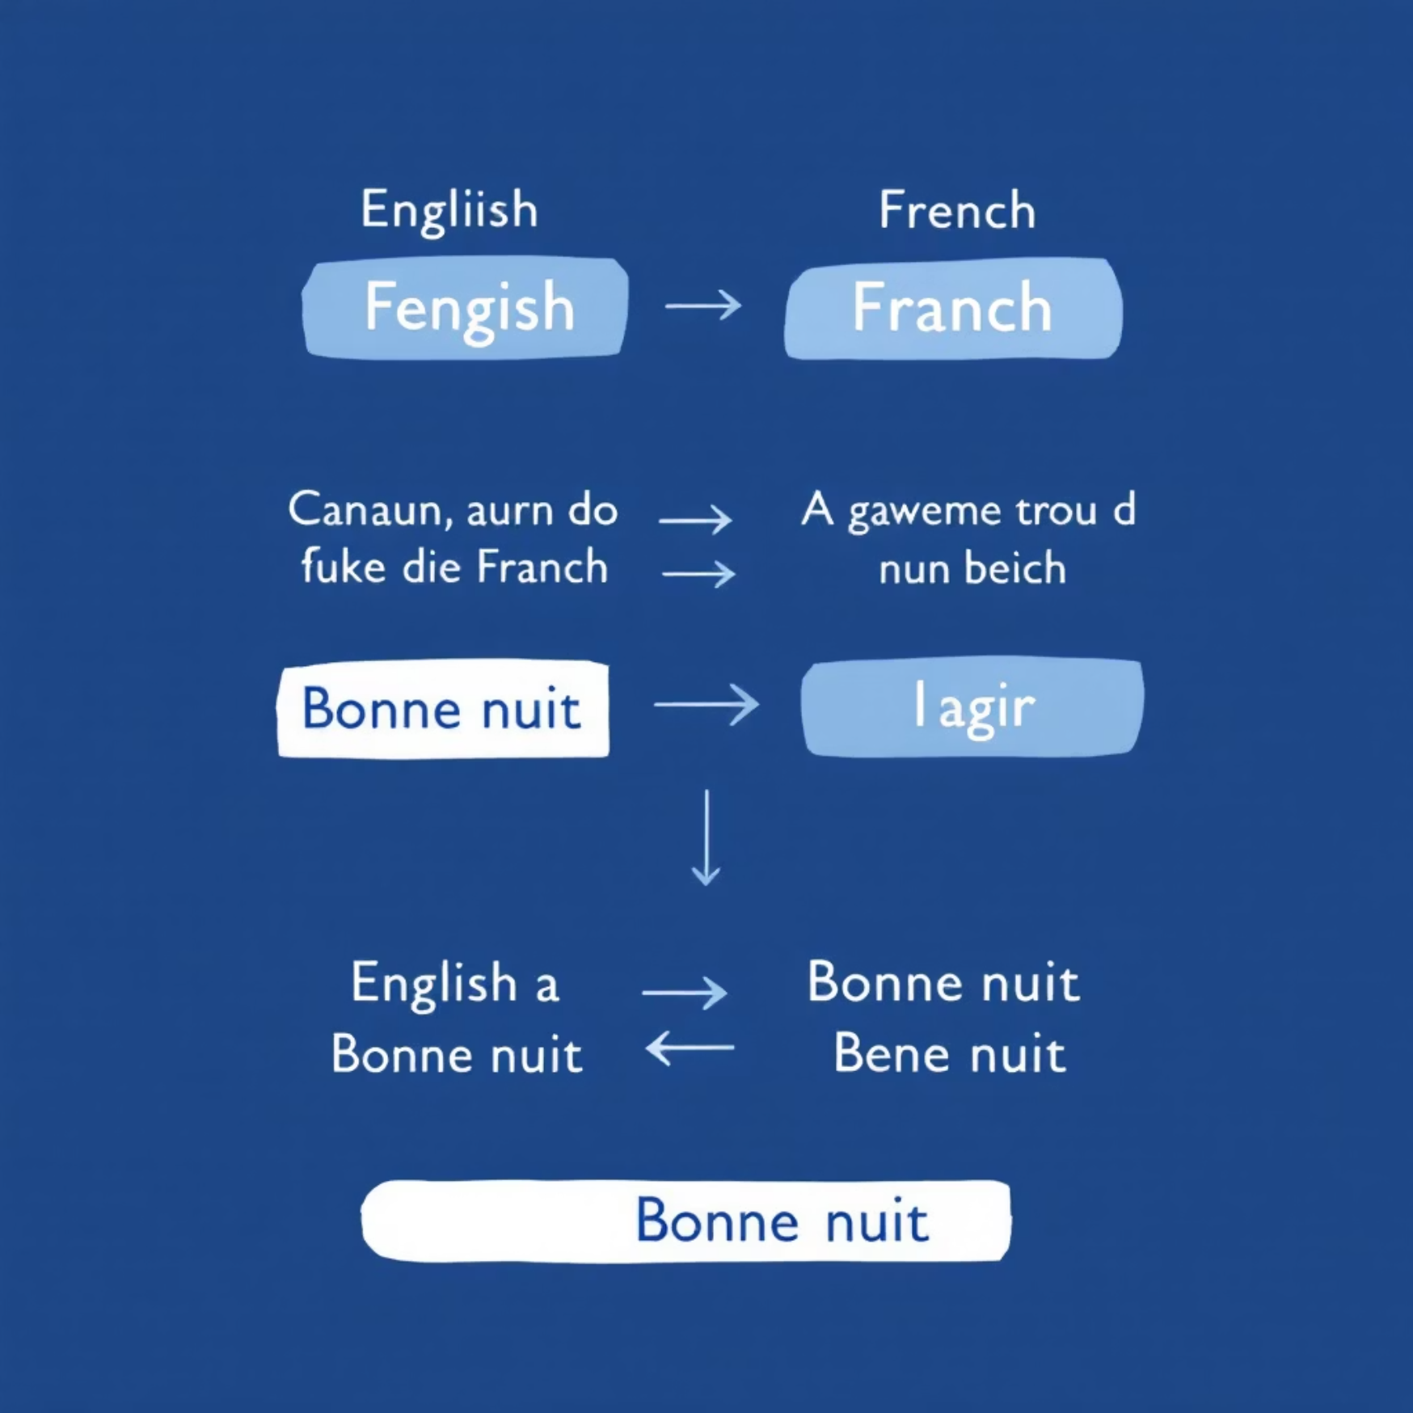
Few-shot Example: Learning by Demonstration
Translate English to French:
Few-shot prompting involves giving the model a few examples of the task you want it to perform. This helps the model infer the pattern and context, leading to more accurate or specific outputs. It's particularly useful for nuanced tasks.
- Hello -> Bonjour
- Thank you -> Merci
- Good morning -> Bonjour
Expected: Bonne nuit
Translate: Good night ->

Slide 5
Comparison: Choosing the Right Approach
Zero-shot
Few-shot
Flexible and quick to implement.
Higher accuracy and better guidance for the model.
Ideal for general tasks without specific format requirements.
Essential for tasks requiring specific formats, styles, or domain knowledge.
May be less accurate for highly specialized or nuanced tasks, as it relies entirely on pre-trained knowledge.
Requires careful curation of examples, which can be time-consuming.
Tradeoff: Few-shot needs curated examples, which demands more effort in prompt engineering but yields more controlled and precise results. Zero-shot offers speed and broad applicability but might lack precision for complex needs.

Slide 6

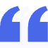
Important Notes
Educational Demo Only
Open Source & Attribution
This presentation is for demonstration and educational purposes. No proprietary or sensitive data was used or processed during its creation.
This project is distributed under the MIT License, encouraging further exploration and development.
CloudByteHub.ai
A personal, independent initiative by T S Narayana Reddy, showcasing insights into AI and prompting techniques.

